Slide 1
Explainable AI with Shapley Values
Scott Lundberg
Microsoft Research

Slide 2
Explainable AI in practice
Model development

Slide 3
Why was I denied?
chance John will have repayment problems
Accuracy = $
model
22%
No loan
What is our
financial risk?
How do I
debug?
John, a bank customer
Notes:
We'll start with a simple motivational example. This is John, a typical bank customer. Like many consumers today, when he applies for a loan, information about him is sent through a predictive model XX.
This model is designed to calculate the risk that John will have repayment problems, XX which, unfortunately for John, is 55%. And because his risk is high, the bank declines his loan application XX.
A natural first question John has XX is “Why?” The bank XX also want to know why, because these are key business decisions. But unfortunately for the data scientist that built this model XX, she used a complex model and so these questions are hard to answer XX …. XX

Slide 4
 | Interpretable | Accurate
Complex model | ✘ | ✔
Simple model | ✔ | ✘
?
?
Interpretable or accurate: choose one.
😀 ⚖️
💰
Notes:
The reason the data scientist used a complex model is because they are often very accurate on large data sets XX, but that same complexity also makes them hard to interpret XX. In contrast, simple models are easy to interpret XX, but are often less accurate XX. This leads to a trade-off XX between interpretability and accuracy.
This trade-off is particularly painful for the bank since accuracy directly corresponds to profitability XX, while interpretability has important implications for customer satisfaction XX and even legality. This tradeoff effects a wide range of applications, and so many recent methods have been developed to address it. XX

Slide 5
Input value
Output value
Complex models are inherently complex!
But a single prediction involves only a small piece of that complexity.
Notes:
These methods do not try and make an entire complex model interpretable, because there is inherently too much to succinctly explain. Instead they focus on explaining a single prediction XX, because mapping a single input to an output involves only a small part of the complexity of the overall model. XX

Slide 6
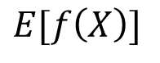

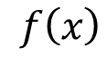
Base rate
Prediction for John
16%
22%
$$0$$
$$E[f\left(X\right)]$$
$$f\left(x\right)$$
How did we get here?
Notes:
To see, let’s return to John and answer why his loan application was denied. To explain his denial it is important to start with the base rate of loan repayment problems XX, denoted here by the expected value of the model’s output.
To explain John's risk XX, we need to explain how we got from the base rate XX, to his risk of 55%. XX

Slide 7
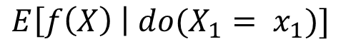
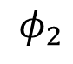
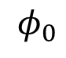
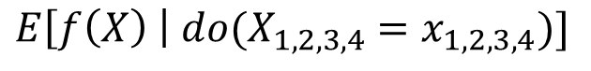
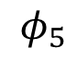
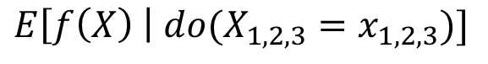
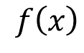
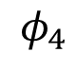
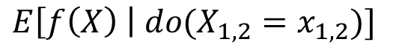
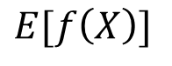
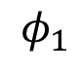
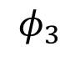
The order matters!
16%
18.2%
18.5%
21%
22%
22.5%
$$E[f\left(X\right)]$$
*
$$E\left[f\left(X\right) \right| {do(X}_{1,2,3}=x_{1,2,3})]$$
$$f\left(x\right)$$
$$E\left[f\left(X\right) \right| do(X_{1}= x_{1})]$$
$$E\left[f\left(X\right) \right| do(X_{1,2}=x_{1,2})]$$
$$0$$
$$E\left[f\left(X\right) \right| do(X_{1,2,3,4}=x_{1,2,3,4})]$$
$$φ_{0}$$
$$φ_{2}$$
$$φ_{1}$$
$$φ_{4}$$
$$φ_{3}$$
Base rate
DTI = 30
Income not verified
Delinquent 10 months ago
No recent account openings
$$φ_{5}$$
*Janzing et al. 2019
46 years of credit history
Notes:
To see, let’s return to John and answer why his loan application was denied. To explain his denial it is important to start with the base rate of loan repayment problems XX, denoted here by the expected value of the model’s output.
To explain John's risk XX, we need to explain how we got from the base rate XX, to his risk of 55%. XX

Slide 8
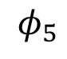
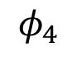
Lloyd Shapley
The order matters!
Nobel Prize in 2012
$$0$$
$$E[f\left(X\right)]$$
$$f\left(x\right)$$
$$φ_{0}$$
$$φ_{2}$$
$$φ_{1}$$
$$φ_{3}$$
$$φ_{5}$$
46 years of credit history
$$φ_{4}$$
No recent account openings
Notes:
To see, let’s return to John and answer why his loan application was denied. To explain his denial it is important to start with the base rate of loan repayment problems XX, denoted here by the expected value of the model’s output.
To explain John's risk XX, we need to explain how we got from the base rate XX, to his risk of 55%. XX

Slide 9
Shapley properties
1
Additivity (local accuracy) – The sum of the local feature attributions equals the difference between the base rate and the model output.
$$0$$
$$E[f\left(X\right)]$$
$$f\left(x\right)$$
$$φ_{0}$$
$$φ_{2}$$
$$φ_{1}$$
$$φ_{3}$$
$$φ_{5}$$
$$φ_{4}$$
Notes:
To see, let’s return to John and answer why his loan application was denied. To explain his denial it is important to start with the base rate of loan repayment problems XX, denoted here by the expected value of the model’s output.
To explain John's risk XX, we need to explain how we got from the base rate XX, to his risk of 55%. XX

Slide 10
Shapley properties
2
Monotonicity (consistency) – If you change the original model such that a feature has a larger impact in every possible ordering, then that input’s attribution should not decrease.
Violating consistency means you can’t trust feature orderings
based on your attributions.
…even within the same model!
$$0$$
$$E[f\left(X\right)]$$
$$f\left(x\right)$$
$$φ_{0}$$
$$φ_{2}$$
$$φ_{1}$$
$$φ_{3}$$
$$φ_{5}$$
$$φ_{4}$$
Notes:
To see, let’s return to John and answer why his loan application was denied. To explain his denial it is important to start with the base rate of loan repayment problems XX, denoted here by the expected value of the model’s output.
To explain John's risk XX, we need to explain how we got from the base rate XX, to his risk of 55%. XX

Slide 11
Shapley values result from averaging over all N! possible orderings.
(NP-hard)
$$0$$
$$E[f\left(X\right)]$$
$$f\left(x\right)$$
$$φ_{0}$$
$$φ_{2}$$
$$φ_{1}$$
$$φ_{3}$$
$$φ_{5}$$
$$φ_{4}$$
Notes:
To see, let’s return to John and answer why his loan application was denied. To explain his denial it is important to start with the base rate of loan repayment problems XX, denoted here by the expected value of the model’s output.
To explain John's risk XX, we need to explain how we got from the base rate XX, to his risk of 55%. XX

Slide 13
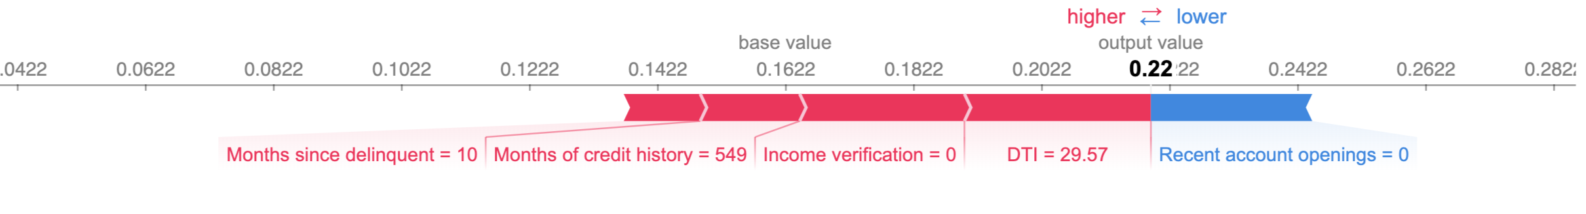
ex = shap.TreeExplainer(model, …)
shap_values = ex.shap_values(X)
shap.force_plot(ex.expected_value, shap_values[john_ind,:], X.iloc[john_ind,:])
Why does 46 years of credit history increase the risk of payment problems?

Slide 14
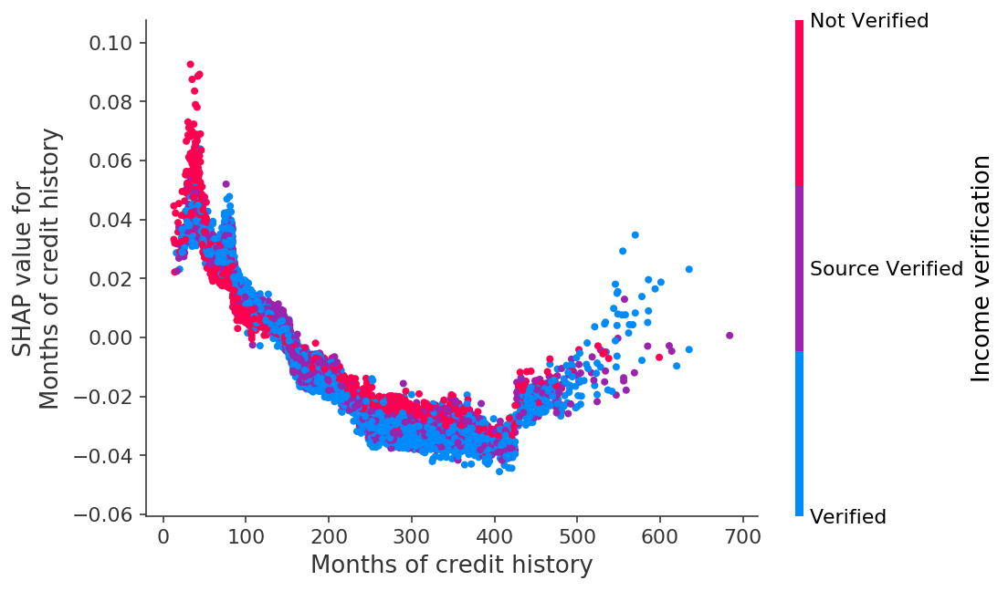
shap.dependence_plot(“Months of credit history”, shap_values, X)
The model is identifying retirement-age individuals based on their long credit histories!
Explain and
debug your models!

Slide 15


Explainable AI in practice
Model development
Debugging/exploration
Monitoring

Slide 16
Model monitoring
Time
Training performance
Test performance
Can you find where we introduced the bug?
Notes:
Make title shorter

Slide 17
Model monitoring
False
True
Now can you find where we introduced the bug?
Notes:
Focus more on for each

Slide 18
Model monitoring
False
True
Time
Transient electronic medical record
Time
Notes:
What is an EMR?

Slide 19
Model monitoring
False
True
Time
Gradual change in atrial fibrillation
ablation procedure durations
Time
Notes:
Make title shorter

Slide 20










Explainable AI in practice
Model development
Human/AI collaboration
Regulatory
compliance
Scientific
discovery
Debugging/exploration
Customer retention
Consumer explanations
Population subtyping
Monitoring
Decision support
Anti-discrimination
Pattern discovery
Encoding prior beliefs
Human risk oversight
Risk management
Signal recovery

Slide 21
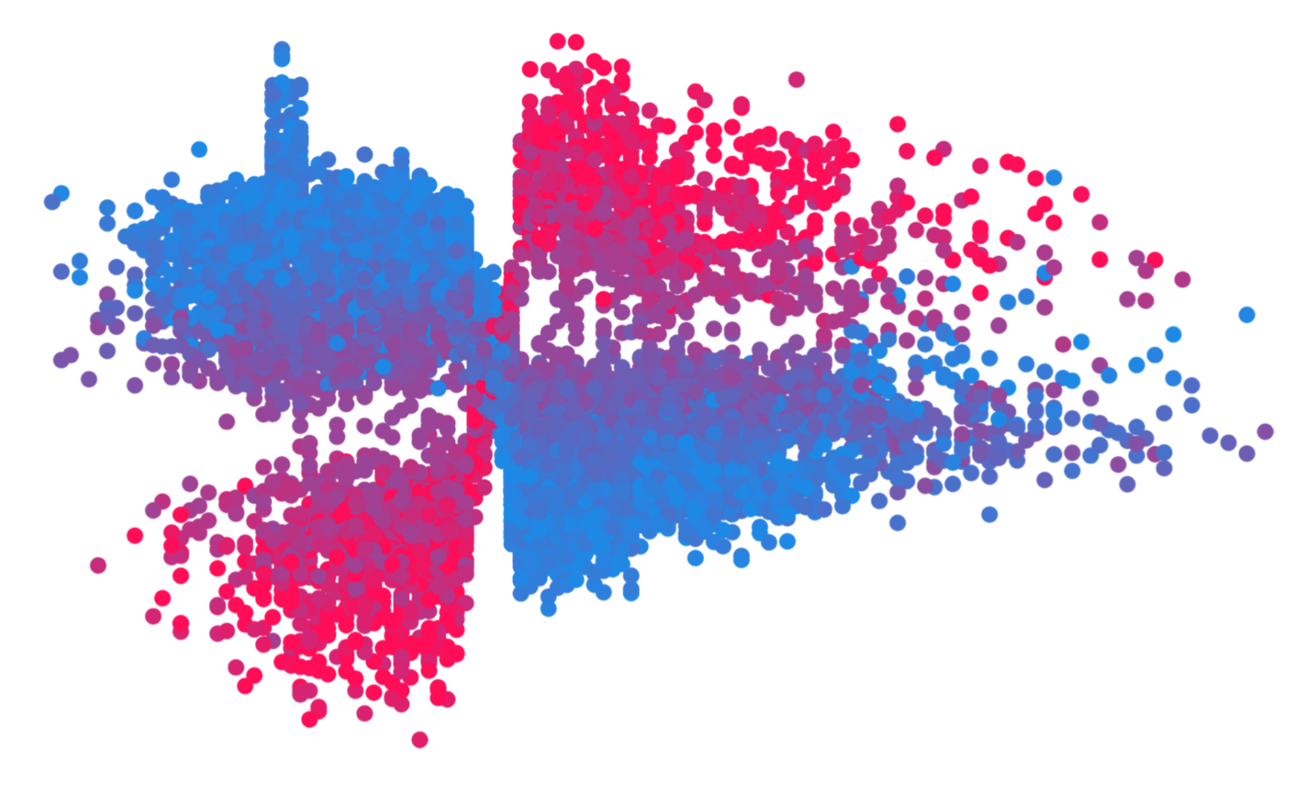
Thanks!
And special thanks to Su-In Lee, Hugh Chen, Gabriel Erion from UW.

Slide 22
Mortality risk model
Notes:
Make title shorter

Slide 23
Mortality risk model
Notes:
Make title shorter

Slide 24
Mortality risk model
Notes:
Make title shorter

Slide 25
Mortality risk model
Notes:
Make title shorter

Slide 26
Mortality risk model
Notes:
Make title shorter

Slide 27
Mortality risk model
Notes:
Make title shorter

Slide 28
Reveal rare high-magnitude mortality effects
Mortality risk model
Conflates the
prevalence of an effect
with the
magnitude of an effect
Notes:
Make title shorter

Slide 29
Reveal rare high-magnitude mortality effects
Notes:
Make title shorter

Slide 30
Reveal rare high-magnitude mortality effects
Rare high magnitude effects
Notes:
Make title shorter

Slide 31
Reveal rare high-magnitude mortality effects
Not many ways to live longer…
Lots of ways to die young…
Notes:
Make title shorter

